Slide 2
Hidden Threats of Technological Enhancements
Dmitry Sklyarov
Head of Reverse Engineering Department
Positive Technologies
31/03/2016 PRAHA

Slide 3
Agenda
Password Managers on Smartphones
Flash Storage Forensics
4G modem – best present ever!

Slide 4
Part I Password Managers on Smartphones

Slide 5
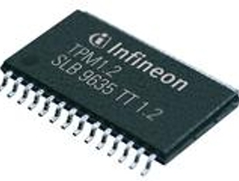
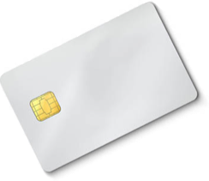
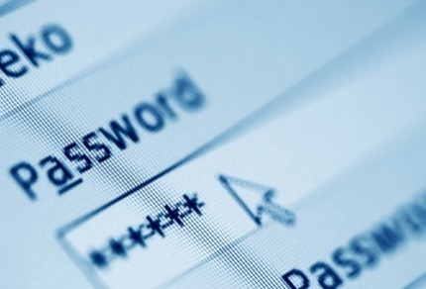
Authentication: PC
Trusted Platform Module
Biometrics
SmartCard + PIN
Password/Passphrase

Slide 6
Authentication: Smartphone
Trusted Platform Module
Biometrics
SmartCard + PIN
Password/Passphrase

Slide 7
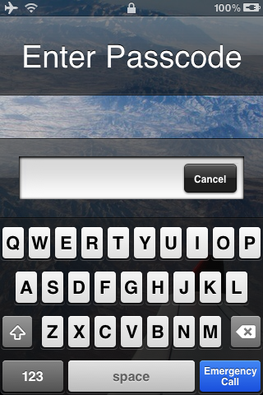
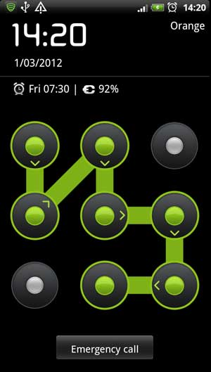
Authentication: Smartphone
Password is the only option on the smartphones
“Lock patterns” are essentially numeric passcodes [1-4-2-5-6-9-8]

Slide 8
Password Typing
Smartphone:
Touch keyboard
Long and complex passwords are hard
PC:
Full-sized keyboard, motor memory
Long and complex passwords are easy

Slide 9
Password Typing
It is fair to assume that passwords on the smartphones are shorter than their PC counterparts

Slide 10
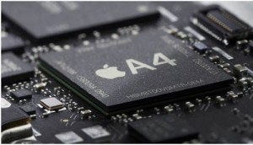
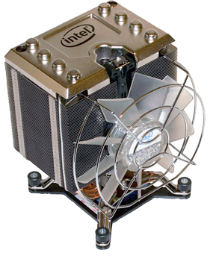
Password Cracking
Smartphone:
Relatively slow CPU
Complex password-to-key transforms will impact usability
PC:
Fast CPU
Can do complex password-to-key transforms

Slide 11
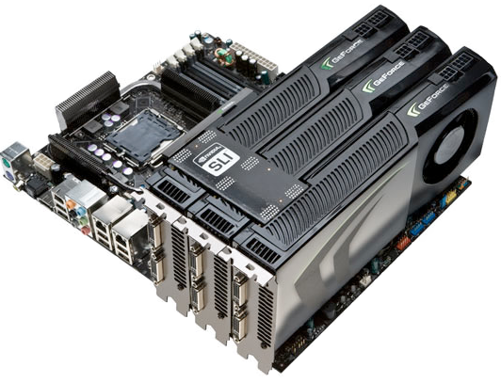
Password Cracking
Offline attacks can utilize GPUs for attackers’ advantage

Slide 12
Authentication Wrap Up
Handling passwords on smartphone is more difficult than on PC
Smartphone requires stronger password protection than PC but provides less capabilities for doing so!
PC:
Password entered not too often (usually just after unlocking console)
Smartphone:
Password entered every time you need access data (after switching applications or after short time-out)

Slide 13
Threat Model
Assumptions:
Attacker has:
Physical access to the device, or
Backup of the device, or
Access to password manager database file
Attacker wants to:
Recover master password for password manager(s) on the mobile device
Extract passwords stored by those managers
Are those assumptions fair at all?

Slide 14
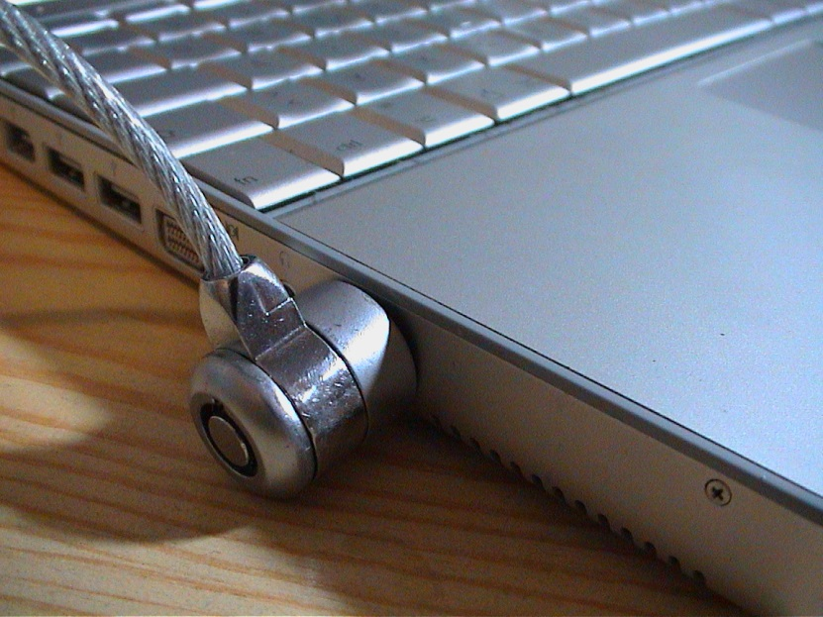
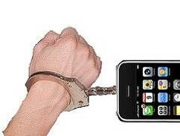
Physical Access
Lots of phones go in wrong hands every year. Many are left in the bars.
Do you really know where exactly your phone is right now?
Computers are relatively big. Thus, hard to steal or lose.
You know where it is (well, most of the time).

Slide 15
Someone just got physical access to the device

Slide 16
Device Backup
Apple iOS:
Need device passcode or iTunes pairing
Optional encryption (enforced by device)
PBKDF2-SHA1 with 10’000 iterations
BlackBerry:
Need device password
Optional encryption (not enforced)
PBKDF2-SHA1 with 20’000 iterations

Slide 17
Database Files
Apple iOS:
Via afc (need passcode or iTunes pairing)
Via SSH (jailbroken devices)
Via physical imaging (up to iPhone 4)
BlackBerry:
Need device password

Slide 18
iOS Passcode
Starting with iOS 4 passcode is involved in encryption of sensitive data
Passcode key derivation is slowed down by doing 50’000 iterations
Each iteration requires talking to hardware AES
6 p/s on iPhone 4
Can’t be performed off-line and scaled
Checking all 6-digit passcodes will take more than 40 hours

Slide 19
Cracking Passwords
Name | Complexity | CPU p/s | GPU p/s | Len/24h
Keeper® Password & Data Vault | 1x MD5 | 60 M | 6000 M | 14.7
Password Safe - iPassSafe Free | 1x AES-256 | 20 M | N/A | 12.2
Strip Lite - Password Manager | 4000x PBKDF2-SHA1 + 1x AES-256 | 5000 | 160 K | 10.1
SafeWallet - Password Manager | 10x PBKDF2-SHA1 + 1x AES-256 | 1500 K | 20 M | 12.2
DataVault Password Manager | 1x SHA-256 + 1x SHA-1 | 7 M | 500 M | 13.6
mSecure - Password Manager | 1x SHA-256 + 1x Blowfish | 300 K | N/A | 10.4
LastPass for Premium Customers | 2x SHA-256 + 1x AES-256 | 5 M | 20 M | 12.2
1Password Pro | 1x MD5 + 1x AES-128 | 15 M | 20 M | 12.2
BlackBerry Password Keeper | 3x PBKDF2-SHA1 + 1x AES-256 | 5 M | 20 M | 12.2
BlackBerry Wallet 1.0 | 2x SHA-256 | 6 M | 300 M | 13.4
BlackBerry Wallet 1.2 | 1x SHA-512 + 100x PBKDF2-SHA1 + 1x AES-256 | 200K | 3200 K | 11.4
iOS passcode | 50000 iterations with HW AES | 6 | 0 | 5.7

Slide 20
Cracking Passwords
Name | Complexity | CPU p/s | GPU p/s | Len/24h
Keeper® Password & Data Vault | 1x MD5 | 60 M | 6000 M | 14.7
Password Safe - iPassSafe Free | 1x AES-256 | 20 M | N/A | 12.2
Strip Lite - Password Manager | 4000x PBKDF2-SHA1 + 1x AES-256 | 5000 | 160 K | 10.1
SafeWallet - Password Manager | 10x PBKDF2-SHA1 + 1x AES-256 | 1500 K | 20 M | 12.2
DataVault Password Manager | 1x SHA-256 + 1x SHA-1 | 7 M | 500 M | 13.6
mSecure - Password Manager | 1x SHA-256 + 1x Blowfish | 300 K | N/A | 10.4
LastPass for Premium Customers | 500x PBKDF2-SHA256 + 1x AES-256 | 12 K | 600 K | 10.7
1Password Pro | 1x MD5 + 1x AES-128 | 15 M | 20 M | 12.2
BlackBerry Password Keeper | 3x PBKDF2-SHA1 + 1x AES-256 | 5 M | 20 M | 12.2
BlackBerry Wallet 1.0 | 2x SHA-256 | 6 M | 300 M | 13.4
BlackBerry Wallet 1.2 | 1x SHA-512 + 100x PBKDF2-SHA1 + 1x AES-256 | 200K | 3200 K | 11.4
iOS passcode | 50000 iterations with HW AES | 6 | 0 | 5.7

Slide 21
Summary
None of the tested password keepers offers reliable protection on top of OS security
Using them on improperly configured device may expose sensitive data
Paid apps are not necessarily more secure than free ones

Slide 22
Part II Flash Storage Forensics

Slide 23
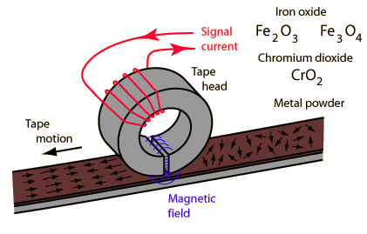
Magnetic Recording
Invented in 1898
Media moves near magnetic head

Slide 24
Magnetic drives becomes smaller …

Slide 25
… and smaller
General principles still the same
Any piece of data could be modified independently
Erasing performed via overwriting
Data erasure standards exists
Toshiba's 0.85” 4GB HDD

Slide 26
Flash Memory
Invented in 1984
Two major types:
NOR (1988, Intel)
NAND (1989, Toshiba)
Stores electrical charge into a floating gate of transistor
Able to retain data for 10-100 years
Intel’s m-SATA 80G SSD (2010)

Slide 27
Flash Memory Characteristics
Any byte could be written independently
Need erase (make all bits=1) before re-writing
Erasing with precision of block (e.g. 64K) only
Limited number of guaranteed erase cycles
Usually between 10’000 and 1’000’000
Inerasable block should be marker as “bad”
Some blocks could be inerasable when leaving factory

Slide 28
Flash Memory Layout
Spare area could be used for:
Marking bad pages/blocks
Storing ECC data
Holding Physical-to-Logical mapping information
Bank 1
Erase Block 1
Page 1
Bank 2
Erase Block 2
Page 2
Data (512b)
Bank 3
Erase Block 3
Page 3
Spare
Bank N
Erase Block N
Page N

Slide 29
Wear Leveling
Goal: evenly spread the erasing of blocks over the full range of physical blocks
Dynamic process that rearranges pages/blocks in order to extend flash lifetime
Algorithms developed by memory device manufacturers
Implementation details usually keeps secret

Slide 30
Logical Characteristics
USB Flash Drive, SSD or Flash Memory Card
Simulates behavior of common HDD
Logical Block Addressing
Logical Address translates to Physical Address by Flash Memory Controller
TRIM command for SSD

Slide 31
Logical Characteristics
Embedded Device (e.g. Smartphone)
Flash-aware firmware
Tight integration between OS and Flash Memory
Logical-to-Physical translation often performed on CPU

Slide 32
Flash Translation Layer (FTL)
Responsible for finding Physical Page that represents actual data for specific Logical Page Number (LPN) of Block device
State of mapping tables is stored in Flash and cached in RAM
Unused (TRIM-ed) LPNs are not mapped at all

Slide 33
Altering data in Flash Storage
Any modification of data changes the mapping
New data is written to new (free) page
Previous version of page data (and content of TRIM-ed pages) still resides somewhere in Flash until block erased due to wear leveling or garbage collection

Slide 34
FTL in iOS devices
Implemented in software (runs on CPU)
Spare area of Data pages contains:
LPN
allows to find all Physical pages that were used to store data of some Logical page
USN (Update Sequence Number)
allows to build the ordered “history” of page copies

Slide 35
Accessing raw Flash on iOS devices
IOFlashControllerUserClient kernel service is available
externalMethod functions allows perform “raw” reading of Physical pages
ReadPage request support removed in iOS 5
RAMdisk based on iOS 4 could help
It is possible to patch the kernel in memory and restore ability to read pages

Slide 36
Which devices could be examined?
Anything prior to iPhone4S/iPad2/iPod5
by loading custom RAMdisk/Kernel
Jailbroken device
by patching kernel in memory
Any iOS device
if you know how to obtain digital signature for your RAMdisk from Apple

Slide 37
How “Forensic” is it?
Not too much…
Booting the iDevice causes some alteration of Flash content
Obtaining Flash dump twice would not produce identical results

Slide 38
Is there secure way to erase data?
Deleting file produces good result at logical level (due to TRIM) – better that HDD
Neither deleting nor overwriting are actually removes the data at physical level – much worse than HDD
Probability of successful data recovery depends on amount of unused space on Flash Storage (more space – more chances)

Slide 39
Part III 4G modem – best present ever!

Slide 40
How it looks (approximately ;)

Slide 41
Explore textual marks on Modem
Front side:
“4G” logo
operator’s logo
Under the cover (access to SIM and SD cards):
operator’s internal model number
IMEI
serial number
Hmm, what the actual manufacturer name and model number?
Back side:
nothing

Slide 42
Explore packaging
Manufacturer name (ZTE) printed on the box and in booklet

Slide 43
ZTE MF823 4G Modem Specification
LTE-FDD: 800/900/1800/2600MHz;
UMTS: 900/2100MHz;
LTE-FDD: DL/UL 100/50Mbps (Category3)
DC-HSPA+: DL/UL 42/5.76Mbps
Size: 90 x 28.4 x 13mm
OS: Win7, Windows XP, Vista, Win8, Mac OS

Slide 44
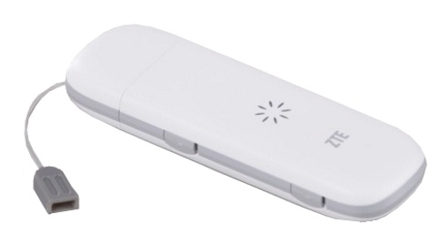
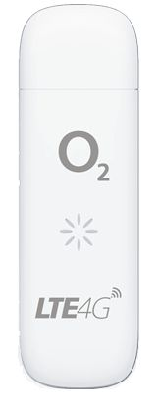
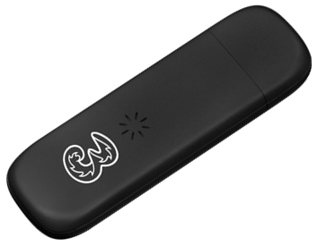
ZTE MF823 4G Modem re-Branding
Altel (Kazakhstan)
Beeline (Russia)
O₂ (Germany)
Three (UK)
MegaFon (Russia)

Slide 45
Is there Modem anymore?
After plugging into PC running Windows 7:
CWID USB SCSI CD-ROM USB Device
ZTE MMC Storage USB Device (MicroSD Card Reader)
After performing “Eject CD Drive”:
CD-ROM (sometimes they come back!)
MicroSD Card Reader
Remote NDIS* based Internet Sharing Device
*NDIS == Network Driver Interface Specification
No drivers required! (at least on Windows 7 ;)

Slide 46
Remote NDIS adapter properties
> ipconfig
Windows IP Configuration
Ethernet adapter Local Area Connection:
Connection-specific DNS Suffix . :
IPv4 Address. . . . . . . . . . . : 192.168.0.182
Subnet Mask . . . . . . . . . . . : 255.255.255.0
Default Gateway . . . . . . . . . : 192.168.0.1

Slide 47
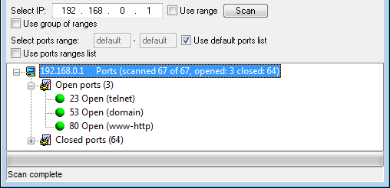
How to speak with MF823?
Results of ports scan for 192.168.0.1

Slide 48
HTTP server on 192.168.0.1
NB: Some brand-customized firmware contains web-interface that relies on “GoForm” handlers
GET / HTTP/1.1
Host: 192.168.0.1
HTTP/1.0 302 Redirect
Server: GoAhead-Webs/2.5.0
Location: http://192.168.0.1/index.html
GET /index.html HTTP/1.1
Host: 192.168.0.1
HTTP/1.1 404 Site or Page Not Found

Slide 49
HTTP server Handlers
Defined UrlHandlers:
/goform
/cgi-bin
/mmc2
/api/xmlclient/post
/client/backup
/api/nvramul.cgi
Defined GoForm handlers:
/goform/goform_get_cmd_process
/goform/goform_set_cmd_process
/goform/goform_process
/goform/formTest

Slide 50
Getting diagnostics info
http://192.168.0.1/goform/ goform_get_cmd_process? cmd=device_diagnostics
Returns:
productName softwareVersion modemVersion
routerVersion webUiVersion hardwareVersion
serialNumber simSerialNumber simMsisdn
deviceImei simImsi simStatus
sdCardAvailable sdCardTotalMemory sdCardUsedMemory
currentConnectedUsers maxConnectedUsers timeSinceStartup

Slide 51
Switching to Download (FACTORY) mode
http://192.168.0.1/goform/goform_process? goformId=MODE_SWITCH&switchCmd=FACTORY
New devices appears:
ZTE Diagnostics Interface (COM_{X})
ZTE NMEA Device (COM_{Y})
ZTE Proprietary USB Modem
NB: Send AT+ZCDRUN=F to COM-port associated with “ZTE NMEA Device” to return from Download mode

Slide 52
telnetd on 192.168.0.1
OpenEmbedded Linux 9615-cdp
msm 20130729 9615-cdp
9615-cdp login: root
Password: zte9x15
root@9615-cdp:~# id
uid=0(root) gid=0(root) groups=0(root)

Slide 53
root is good!
Full-featured ARM-based Linux
busybox apps (e.g. nc and netstat)
iptables
tcpdump
gdbserver
CD image at /usr/zte_web/ZTEMODEM.ISO
HTTP server root at /usr/zte_web/web/*
auto_apn
copy
zte_log

Slide 54
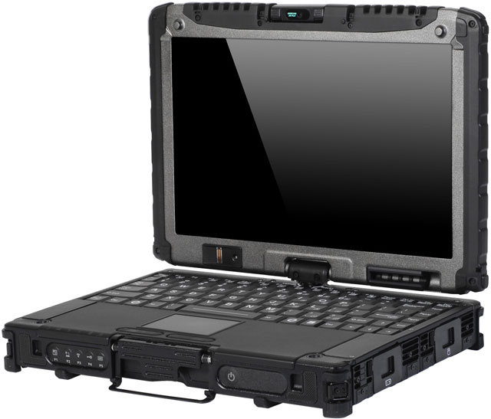
What is actually under your control?

Slide 55
What is actually under your control?

Slide 56
What are the treats?
log all internet activity
controls all external traffic
replicate all internet activity
under remote management
access to local network?
WiFi-enabled? access to local WiFi
GPS-enabled? store/report GPS location

Slide 57
My favorite Modem ;)

Slide 58
Dmitry Sklyarov
Head of Reverse Engineering Department
Positive Technologies
DSklyarov@ptsecurity.com

